Slide 1



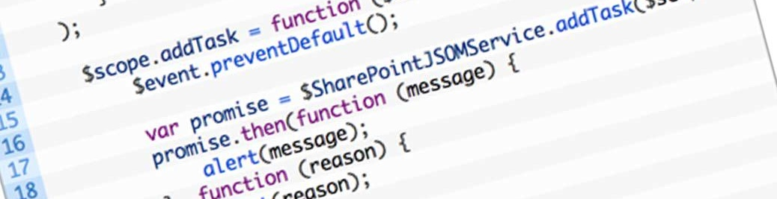
Introduction to AngularJS
Super Heroic JavaScript MVC Framework
SoftUni Team
Technical Trainers
Software University
http://softuni.bg

Slide 2


Table of Contents
What is AngularJS?
Introduction
MV* Frameworks
Features
Architecture
Components
Hello World Applications
Angular Seed
Required Software

Slide 3

What is AngularJS?

Slide 4
What is AngularJS?
AngularJS is a web applications framework
JavaScript framework for creating single page web applications
AngularJS is an open-source
Created and maintained by Google
Extends traditional HTML to present dynamic content
MV*-based JavaScript framework

Slide 5
MV* Frameworks
Model – Represents data
View – Manages the display of information
* - Controller, presenter or view model
Model
Controller
Presenter
View
Controller ViewModel Presenter
*
ViewModel

Slide 6

AngularJS Features
Expressions
Filters
Routing
Templates
Directives
Animations
Unit Testing

Slide 7
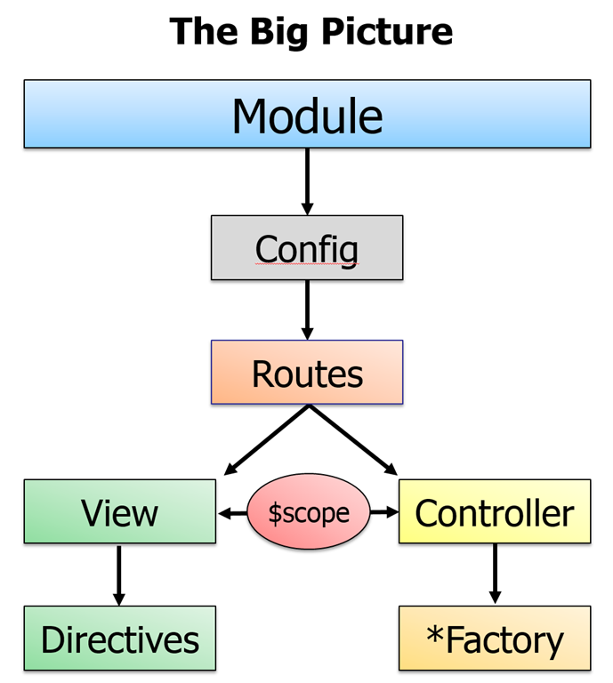
AngularJS Architecture
Two way data-binding
Dirty checking
Dependency injection

Slide 8
AngularJS Components
Services
Controllers
Views / Directives

Slide 9

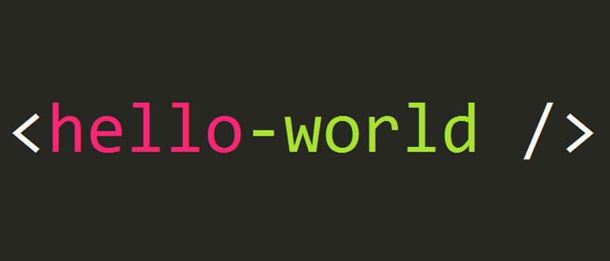
Hello World Application
Live Demo

Slide 10

AngularJS Seed
Skeleton for AngularJS Web Application

Slide 11
What is AngularJS Seed?
Official applications skeleton
Perfect for small applications
It has good architecture
Contains example tests
For bigger applications you need to modify it
Download from:
https://github.com/angular/angular-seed

Slide 12
AngularJS Seed
Live Demo

Slide 13
Required Software
AngularJS
WebStorm / Sublime Text / other
NodeJS
Console / Command Prompt

Slide 14


Summary
What is AngularJS?
What are the key features of AngularJS?
What is scope in AngularJS?
What is two-way data binding?
JS Apps

Slide 15







SPA with AngularJS
https://softuni.bg/courses/spa-applications-angularjs

Slide 16
License
This course (slides, examples, demos, videos, homework, etc.) is licensed under the "Creative Commons Attribution-NonCommercial-ShareAlike 4.0 International" license
Attribution: this work may contain portions from
"SPA with AngularJS" course by Telerik Academy under CC-BY-NC-SA license

Slide 17





Free Trainings @ Software University
Software University Foundation – softuni.org
Software University – High-Quality Education, Profession and Job for Software Developers
softuni.bg
Software University @ Facebook
facebook.com/SoftwareUniversity
Software University @ YouTube
youtube.com/SoftwareUniversity
Software University Forums – forum.softuni.bg

